Slide 1
Mark 8:27 – 9:1
For too long,
the suffering, dying Jesus,
Has been misrepresented
as the one who disconnects his followers
from suffering and dying
People of faith gladly accept the cost of discipleship
Those without faith are repulsed by the cost

Slide 2
²⁷ And Jesus went on with his disciples to the villages of Caesarea Philippi. And on the way he asked his disciples, “Who do people say that I am?” ²⁸ And they told him, “John the Baptist; and others say, Elijah; and others, one of the prophets.” ²⁹ And he asked them, “But who do you say that I am?” Peter answered him, “You are the Christ.” ³⁰ And he strictly charged them to tell no one about him.

Slide 3
³¹ And he began to teach them that the Son of Man must suffer many things and be rejected by the elders and the chief priests and the scribes and be killed, and after three days rise again. ³² And he said this plainly. And Peter took him aside and began to rebuke him. ³³ But turning and seeing his disciples, he rebuked Peter and said, “Get behind me, Satan! For you are not setting your mind on the things of God, but on the things of man.”

Slide 4
³⁴ And calling the crowd to him with his disciples, he said to them, “If anyone would come after me, let him deny himself and take up his cross and follow me. ³⁵ For whoever would save his life will lose it, but whoever loses his life for my sake and the gospel’s will save it. ³⁶ For what does it profit a man to gain the whole world and forfeit his soul? ³⁷ For what can a man give in return for his soul? ³⁸ For whoever is ashamed of me and of my words in this adulterous and sinful generation, of him will the Son of Man also be ashamed when he comes in the glory of his Father with the holy angels.”

Slide 5
9 And he said to them, “Truly, I say to you, there are some standing here who will not taste death until they see the kingdom of God after it has come with power.”

Slide 6
Mark 8:27 – 9:1
For too long,
the suffering, dying Jesus,
Has been misrepresented
as the one who disconnects his followers
from suffering and dying
People of faith gladly accept the cost of discipleship
Those without faith are repulsed by the cost

Slide 7
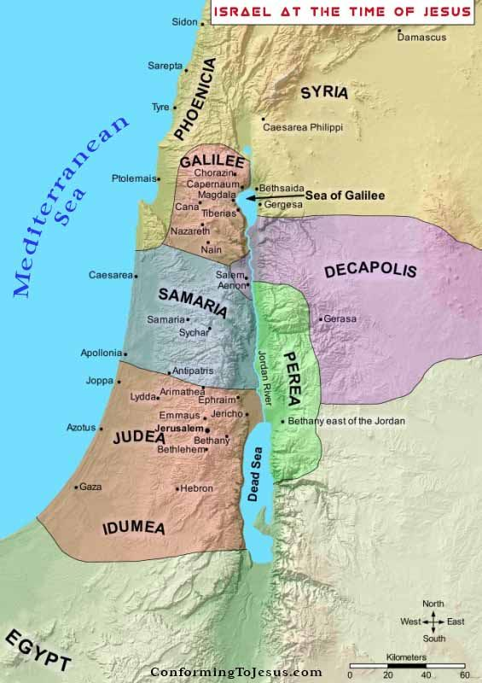
Caesaria Philippi
Jerusalem

Slide 8
A turning point in the Gospel of mark
From the far North of Israel, Jesus begins his journey to Jerusalem and the cross
The identity of Jesus is known (You are the Christ)
Jesus is the Son of Man – The eternal King of the eternal Kingdom. He will judge and rule. But first He must suffer.

Slide 9
Who is Jesus?
Who do you say that I am?
The Christ – the anointed one; Messiah; the one who comes to save
Expected the Messiah to miraculously lead them to defeat their Roman oppressors (military & political leader)

Slide 10
³¹ And he began to teach them that the Son of Man must suffer many things and be rejected by the elders and the chief priests and the scribes and be killed, and after three days rise again. ³² And he said this plainly.
And Peter took him aside and began to rebuke him. ³³ But turning and seeing his disciples, he rebuked Peter and said, “Get behind me, Satan! For you are not setting your mind on the things of God, but on the things of man.”

Slide 11
Who is Jesus?
Who do you say that I am?
The Christ – the anointed one; Messiah; the one who comes to judge and save
Expected the Messiah to miraculously lead them to defeat their Roman oppressors (military & political leader)
But The “Son of Man” would: Be rejected; Suffer; Die; Rise again
The way of God is not the way of men
Man’s way: immediate worldly blessings; recognition; acceptance; satisfaction; affirmation (focuses on this world)
Be careful not to project our aspirations onto Jesus & amend His teaching to suit our own agenda

Slide 12
³⁴ And calling the crowd to him with his disciples, he said to them, “If anyone would come after me, let him deny himself and take up his cross and follow me. ³⁵ For whoever would save his life will lose it, but whoever loses his life for my sake and the gospel’s will save it. ³⁶ For what does it profit a man to gain the whole world and forfeit his soul? ³⁷ For what can a man give in return for his soul? ³⁸ For whoever is ashamed of me and of my words in this adulterous and sinful generation, of him will the Son of Man also be ashamed when he comes in the glory of his Father with the holy angels.”

Slide 13
The Christ – the anointed one; Messiah; the one who comes to judge and save
Expected the Messiah to miraculously lead them to defeat their Roman oppressors (military & political leader)
But The “Son of Man” would: Be rejected; Suffer; Die; Rise again
The way of God is not the way of men
Man’s way: immediate worldly blessings; recognition; acceptance; satisfaction; affirmation (focuses on this world)
Be careful not to project our aspirations onto Jesus & amend His teaching to suit our own agenda
Being a Disciple of Jesus:
We disown / renounce ourselves & embrace Christ
Take up our cross – ^{Mark 13:13}“All men will hate you because of me” .
Be prepared for persecution and even death as we remain loyal followers of Jesus

Slide 14
³⁴ And calling the crowd to him with his disciples, he said to them, “If anyone would come after me, let him deny himself and take up his cross and follow me. ³⁵ For whoever would save his life will lose it, but whoever loses his life for my sake and the gospel’s will save it. ³⁶ For what does it profit a man to gain the whole world and forfeit his soul? ³⁷ For what can a man give in return for his soul? ³⁸ For whoever is ashamed of me and of my words in this adulterous and sinful generation, of him will the Son of Man also be ashamed when he comes in the glory of his Father with the holy angels.”

Slide 15
The Christ – the anointed one; Messiah; the one who comes to judge and save
Expected the Messiah to miraculously lead them to defeat their Roman oppressors (military & political leader)
But The “Son of Man” would: Be rejected; Suffer; Die; Rise again
The way of God is not the way of men
Man’s way: immediate worldly blessings; recognition; acceptance; satisfaction; affirmation (focuses on this world)
Be careful not to project our aspirations onto Jesus & amend His teaching to suit our own agenda
Being a Disciple of Jesus:
We disown / renounce ourselves & embrace Christ
Take up our cross – ^{Mark 13:13}“All men will hate you because of me” .
Be prepared for persecution and even death as we remain loyal followers of Jesus
We don’t give up on life to die – we give our life over to Christ to live for Him
If we truly love Jesus & Live for Him, we will be sharing His Good News with others

Slide 16
³⁴ And calling the crowd to him with his disciples, he said to them, “If anyone would come after me, let him deny himself and take up his cross and follow me. ³⁵ For whoever would save his life will lose it, but whoever loses his life for my sake and the gospel’s will save it. ³⁶ For what does it profit a man to gain the whole world and forfeit his soul? ³⁷ For what can a man give in return for his soul? ³⁸ For whoever is ashamed of me and of my words in this adulterous and sinful generation, of him will the Son of Man also be ashamed when he comes in the glory of his Father with the holy angels.”

Slide 17
³⁴ And calling the crowd to him with his disciples, he said to them, “If anyone would come after me, let him deny himself and take up his cross and follow me. ³⁵ For whoever would save his life will lose it, but whoever loses his life for my sake and the gospel’s will save it. ³⁶ For what does it profit a man to gain the whole world and forfeit his soul? ³⁷ For what can a man give in return for his soul? ³⁸ For whoever is ashamed of me and of my words in this adulterous and sinful generation, of him will the Son of Man also be ashamed when he comes in the glory of his Father with the holy angels.”

Slide 18
The Christ – the anointed one; Messiah; the one who comes to judge and save
But first: The “Son of Man” would: Be rejected; Suffer; Die; Rise again
Man’s way: immediate worldly blessings; recognition; acceptance; satisfaction; affirmation (focuses on this world)
The way of God is not the way of men
Being a Disciple of Jesus:
We disown / renounce ourselves & embrace Christ
Take up our cross – ^{Mark 13:13}“All men will hate you because of me” .
Be prepared for persecution and even death as we remain loyal followers of Jesus
We don’t give up on life to die – we give our life over to Christ to live for Him
If we truly love Jesus & Live for Him, we will be sharing His Good News with others
The way of discipleship, doesn’t make sense without having an eternal perspective
Turning away from what is temporary / carnal to what is eternal / Spiritual
Christians are under great pressure to be ‘conformed’ to worldly society
To be ashamed of Jesus & His words – To conceal our allegiance to Jesus and our allegiance to His teaching
The world hates those who hold to Christ and His teaching (& make it known to the world), because they feel judged themselves
Preaching the Gospel isn’t about ‘hating’ – It’s revealing the Good News of Jesus

